Slide 1

Programming Languages
Third Edition
Chapter 8
Data Types

Slide 2
Objectives
Understand data types and type information
Understand simple types
Understand type constructors
Be able to distinguish type nomenclature in sample languages
Understand type equivalence
Programming Languages, Third Edition

Slide 3
Objectives (cont’d.)
Understand type checking
Understand type conversion
Understand polymorphic type checking
Understand explicit polymorphism
Perform type checking in TinyAda
Programming Languages, Third Edition

Slide 4
Introduction
Every program uses data, either explicitly or implicitly, to arrive at a result
Data type: the basic concept underlying the representation of data in programming languages
Data in its most primitive form is simply a collection of bits
  This does not provide the kinds of abstraction necessary for large programs
Programming languages include a set of simple data entities and mechanisms for constructing new ones
Programming Languages, Third Edition

Slide 5
Introduction (cont’d.)
Machine dependencies are often part of the implementation of these abstractions
Finitude of data:
  In mathematics, integer set is infinite
  In hardware, there is always a largest and smallest integer
Much disagreement among language designers on the extent to which type information should be made explicit and used to verify program correctness
Programming Languages, Third Edition

Slide 6
Introduction (cont’d.)
Reasons to have some form of static type-checking:
  Execution efficiency: allows compilers to allocate memory efficiently
  Translation efficiency: static types allow the compiler to reduce the amount of code to be compiled
  Writability: allows many common programming errors to be caught early
  Security and reliability: reduces the number of execution errors
Programming Languages, Third Edition

Slide 7
Introduction (cont’d.)
Reasons to have some form of static type-checking (cont’d.):
  Readability: explicit types help to document data design
  Remove ambiguities: explicit types can be used to resolve overloading
  Design tool: explicit types highlight design errors and show up as translation-time errors
  Interface consistency and correctness: explicit data types help in verification of large programs
Data type: the basic abstraction mechanism
Programming Languages, Third Edition

Slide 8
Data Types and Type Information
Program data can be classified according to their types
Type name represents the possible values that a variable of that type can hold and the way those values are represented internally
Data type (definition 1): a set of values
  means the same as
Data type (definition 2): a set of values, together with a set of operations on that values having certain properties
  A data type is actually a mathematical algebra
Programming Languages, Third Edition

Slide 9
Data Types and Type Information (cont’d.)
Type checking: the process a translator goes through to determine whether type information in a program is consistent
Type inference: the process of attaching types to expressions
Type constructors: mechanisms used with a group of basic types to construct more complex types
  Example: Array takes a base type and a size or range indication and constructs a new data type
User-defined types: types created using type constructors
Programming Languages, Third Edition

Slide 10
Data Types and Type Information (cont’d.)
Type declaration (or type definition): used to associate a name with a new data type
Anonymous type: a type with no name
  Can use typedef in C to assign a name
Type equivalence: rules for determining if two types are the same
Type system: methods for constructing types, the type equivalence algorithm, type inference rules, and type correctness rules
Programming Languages, Third Edition

Slide 11
Data Types and Type Information (cont’d.)
Strongly typed: a language that specifies a statically applied type system that guarantees all data-corrupting errors will be detected at the earliest possible point
  Errors are detected at translation time, with a few exceptions (such as array subscript bounds)
Unsafe programs: programs with data-corrupting errors
Legal programs: proper subset of safe programs; those programs accepted by a translator
Programming Languages, Third Edition

Slide 12
Data Types and Type Information (cont’d.)
Weakly-typed language: one that has loopholes that may allow unsafe programs
Untyped (or dynamically typed) languages: languages without static type systems
  All safety checking is performed at execution time
Polymorphism: allows names to have multiple types while still permitting static type checking
Programming Languages, Third Edition

Slide 13
Simple Types
Predefined types: those types supplied with a language, from which all other types are constructed
  Generally specified using either keywords or predefined identifiers
  May include some variations on basic types, such as for numeric types
Simple types: have no other structure than their inherent arithmetic or sequential structure
  Usually includes predefined types
  Includes enumerated types and subrange types
Programming Languages, Third Edition

Slide 14
Simple Types (cont’d.)
Enumerated types: sets whose elements are named and listed explicitly
  Example: In C:
  Are ordered in most languages: order in which the values are listed is important
  Most languages include a predefined successor and predecessor operation for enumerated types
  No assumptions are made about how the listed values are represented internally
Programming Languages, Third Edition

Slide 15
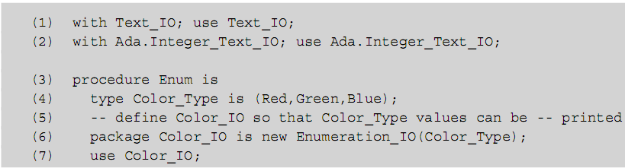
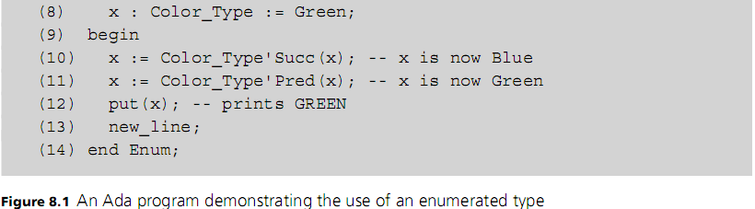
Simple Types (cont’d.)
Programming Languages, Third Edition

Slide 16
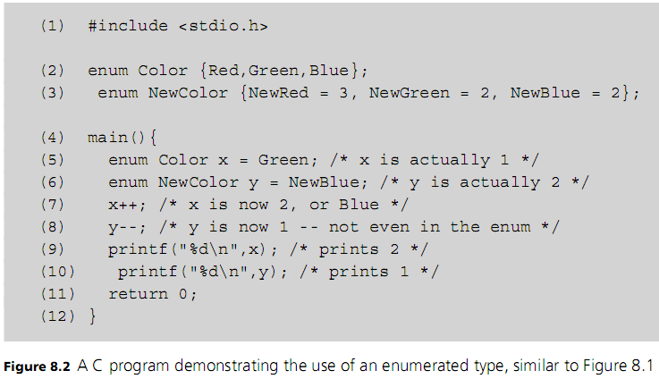
Simple Types (cont’d.)
Programming Languages, Third Edition

Slide 17
Simple Types (cont’d.)
Subrange types: contiguous subsets of simple types specified by giving least and greatest elements
  Example:
Ordinal types: types that exhibit a discrete order on the set of values
  All numeric integer types are ordinal types
  Always have comparison operators
  Often have successor and predecessor operations
Real numbers are not ordinal; they have no successor and predecessor operations
Programming Languages, Third Edition

Slide 18
Simple Types (cont’d.)
Allocation schemes are usually dependent on the underlying hardware for efficiency
IEEE 754 standard tries to define standard representations
Programming Languages, Third Edition

Slide 19
Type Constructors
Since data types are sets, set operations can be used to construct new types from existing ones
Set operations that can be used include Cartesian product, union, powerset, function set, and subset
  These set operations are called type constructors
Example: subrange type is formed using subset construction
There are type constructors that do not correspond to mathematical set constructions, and some set operations that do not correspond to type constructors
Programming Languages, Third Edition

Slide 20
Cartesian Product
Given two sets U and V, the Cartesian product (or cross product) consists of all ordered pairs of elements from U and V:
In many languages, the Cartesian product type constructor is available as the record or structure construction
Programming Languages, Third Edition

Slide 21
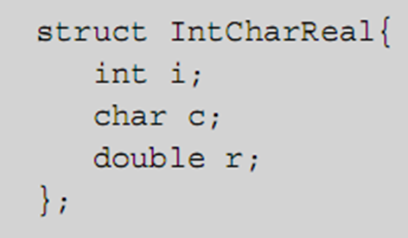
Cartesian Product (cont’d.)
Example: In C, this struct declaration constructs the Cartesian product of type
Programming Languages, Third Edition

Slide 22
Cartesian Product (cont’d.)
Difference between a Cartesian product and a record structure:
  In a record structure, components have names
  In a Cartesian product, they are referred to by position
Most languages consider component names to be part of the type defined by a record structure
Tuple: a purer form of record structure in ML that is essentially identical to the Cartesian product
Programming Languages, Third Edition

Slide 23
Cartesian Product (cont’d.)
Class: a data type found in object-oriented languages
  Includes member functions or methods
  Closer to the second definition of data type, which includes functions that act on the data
Programming Languages, Third Edition

Slide 24
Union
Union of two types: formed by taking the set theoretic union of the sets of their values
Two varieties
  Discriminated unions: a tag or discriminator is added to the union to distinguish the type of its elements
  Undiscriminated unions: lack the tags; assumptions must be made about the type of any value
A language with undiscriminated unions has an unsafe type system
Programming Languages, Third Edition

Slide 25
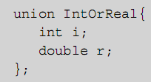
Union (cont’d.)
In C and C++, the union type constructor creates undiscriminated unions
Example:
  If x is a variable of type union IntOrReal, x.i is interpreted as an int, and x.r is interpreted as a double
Programming Languages, Third Edition

Slide 26
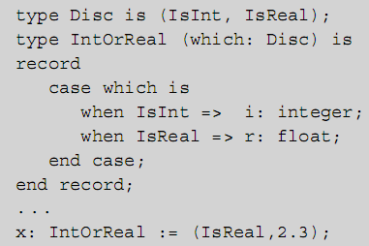
Union (cont’d.)
Ada has a completely safe union mechanism called a variant record
Programming Languages, Third Edition

Slide 27
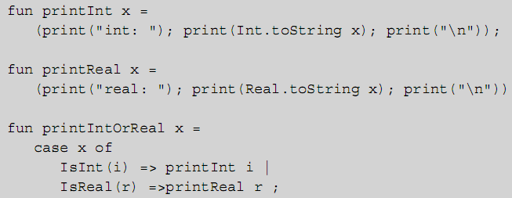
Union (cont’d.)
In ML, declare an enumeration with the vertical bar for “or”:
Then use pattern matching:
Programming Languages, Third Edition

Slide 28
Union (cont’d.)
The tags IsInt and IsReal in ML are called data constructors, since they construct data of each kind within a union
Unions are useful in reducing memory allocation requirements for structures when different data items are not needed simultaneously
Unions are not needed in object-oriented languages
  Use inheritance to represent different non-overlapping data requirements
Programming Languages, Third Edition

Slide 29

Subset
A subset in math is specified by giving a rule to distinguish its elements
Similar rules can be given in programming languages to establish new types as subsets of known types
Ada has a subtype mechanism:
Variant parts of records can be fixed using subtype
Programming Languages, Third Edition

Slide 30
Subset (cont’d.)
Such subset types inherit operations from their parent types
  Most languages do not allow the programmer to specify which operations are inherited and which are not
Inheritance in object-oriented languages can also be viewed as a subtype mechanism
  With a great deal more control over which operations are inherited
Programming Languages, Third Edition

Slide 31
Arrays and Functions
The set of all functions f:U→V can give rise to a new type in two ways:
  Array type
  Function type
If U is an ordinal type, the function f can be thought of as an array with index type U and component type V
  If i is in U, then f(i) is the i^{th} component of the array
  Whole function can be represented by the sequence or tuples of its values (f(low),…,f(high))
Programming Languages, Third Edition

Slide 32
Arrays and Functions (cont’d.)
Arrays are sometimes called sequence types
Typically, array types can be defined with or without sizes
  To define a variable of an array type, usually necessary to specify size at translation time since arrays are normally allocated statically
In C, the size of an array must be a literal, not a computed constant
Cannot dynamically define an array size in C or C++
Programming Languages, Third Edition

Slide 33
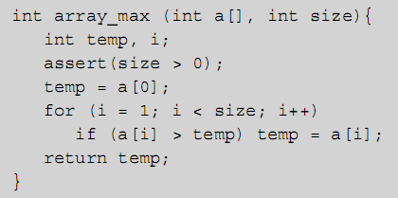
Arrays and Functions (cont’d.)
C allows arrays without specified size to be parameters to functions (they are essentially pointers), but the size must be supplied
  Size of the array is not part of the array in C or C++
Programming Languages, Third Edition

Slide 34
Arrays and Functions (cont’d.)
In Java, arrays are always dynamically (heap) allocated, and the size can be dynamically specified (but cannot change)
  Size is stored when an array is allocated in its length property
Programming Languages, Third Edition

Slide 35
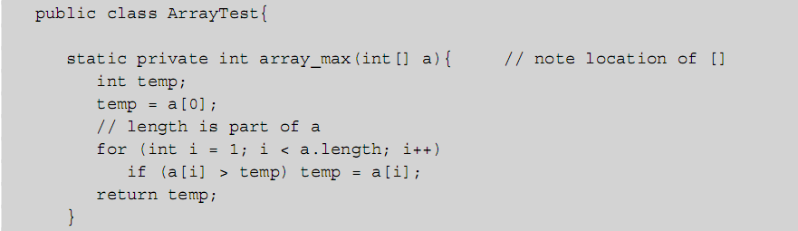
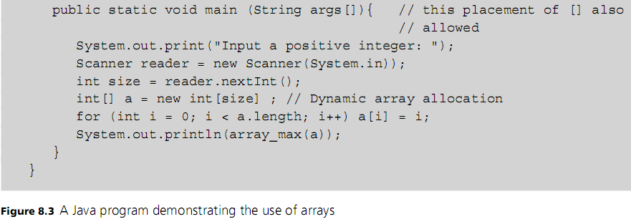
Programming Languages, Third Edition

Slide 36
Arrays and Functions (cont’d.)
Ada allows array types declared without a size, called unconstrained arrays, but requires a size when array variables are declared
Multidimensional arrays are also possible
Arrays are perhaps the most widely used type constructor
Implementation is extremely efficient
  Space is allocated sequentially in memory
  Indexing is performed by an offset calculation from the starting address
Programming Languages, Third Edition

Slide 37
Arrays and Functions (cont’d.)
For multidimensional arrays, must decide which index to use first in the allocation scheme
  Row-major form: all values of the first row are allocated first, then all values of the second row, etc.
  Column-major form: all values of the first column are allocated first, then all values of the second column, etc.
Functional languages usually do not supply an array type; most use the list in place of an array
  Scheme has a vector type
Programming Languages, Third Edition

Slide 38
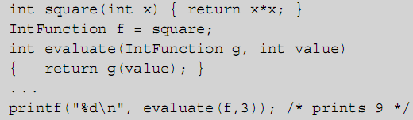
Arrays and Functions (cont’d.)
General function and procedure types can be created in some languages
Example: in C, define a function type from integers to integers:
  Use this type for variables or parameters:
Programming Languages, Third Edition

Slide 39
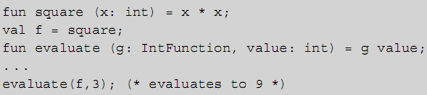
Arrays and Functions (cont’d.)
In ML, you can define a function type:
  Use it in a similar fashion:
Programming Languages, Third Edition

Slide 40
Pointers and Recursive Types
Reference or pointer constructor: constructs the set of all addresses that refer to a specified type
  Does not correspond to a set operation
Example in C:
  Constructs the type of all addresses where integers are stored
Pointers are implicit in languages that perform automatic memory management
  In Java, all objects are implicitly pointers that are allocated explicitly (using the new operator) but deallocated automatically by garbage collection
Programming Languages, Third Edition

Slide 41
Pointers and Recursive Types (cont’d.)
Reference: address of an object under control of the system that cannot be used as a value or operated on in any way (except copying)
Pointer: can be used as a value and manipulated by the programming
References in C++ are created by a postfix & operator
Recursive type: a type that uses itself in its declaration
Programming Languages, Third Edition

Slide 42
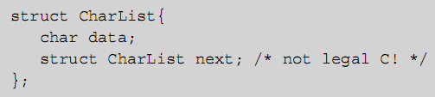
Pointers and Recursive Types (cont’d.)
Recursive types are important in data structures and algorithms
  Represent data whose size and structure is not known in advance and may change as computation proceeds
  Examples: lists and binary trees
Consider this C-like declaration of lists of characters:
Programming Languages, Third Edition

Slide 43
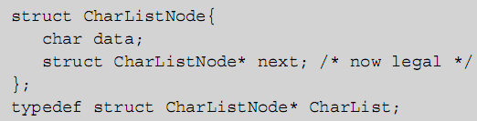
Pointers and Recursive Types (cont’d.)
C requires that each data type have a fixed maximum size determined at translation time
  Must use pointer to allow manual dynamic allocation to overcome this problem
  Each individual element in a CharListNode now has a fixed size, and they can be strung together to form a list of arbitrary size
Programming Languages, Third Edition

Slide 44
Data Types and the Environment
Pointer types, recursive types, and general function types require space to be allocated dynamically
  Require fully dynamic environments with automatic allocation and deallocation (garbage collection)
  Found in the functional languages and the more dynamic object-oriented languages
More traditional languages (C++ and Ada) restrict these types so that a heap (a dynamic space under programming control) is sufficient
Environment issues will be discussed in full in Chapter 10
Programming Languages, Third Edition

Slide 45
Type Nomenclature in Sample Languages
Various language definitions use different and confusing terminology to define similar things
This section gives a brief description of the differences among three languages: C, Java, and Ada
Programming Languages, Third Edition

Slide 46
C
Simple data types are called basic types, including:
  void type
  Numeric types:
    Integral types, which are ordinal (12 possible kinds)
    Floating types (3 possible kinds)
Integral types can be signed or unsigned
Derived types: constructed using type constructors
Programming Languages, Third Edition

Slide 47
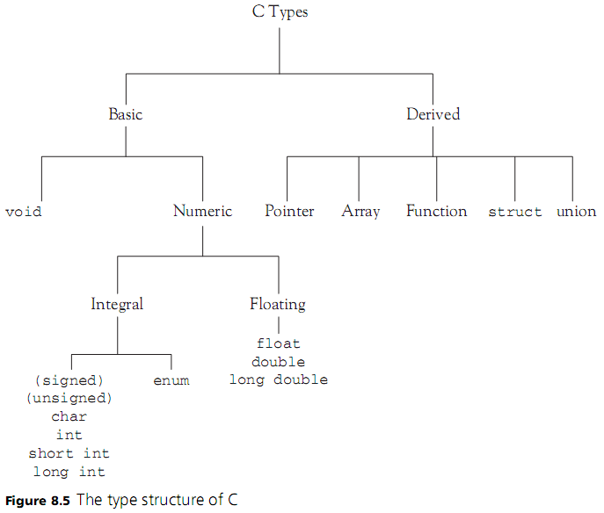
Programming Languages, Third Edition

Slide 48
Java
Simple types are called primitive types, including:
  Boolean (not numeric or ordinal)
  Numeric, including:
    Integral (ordinal)
    Floating point
Reference types: constructed using type constructors
  Array
  Class
  Interface
Programming Languages, Third Edition

Slide 49
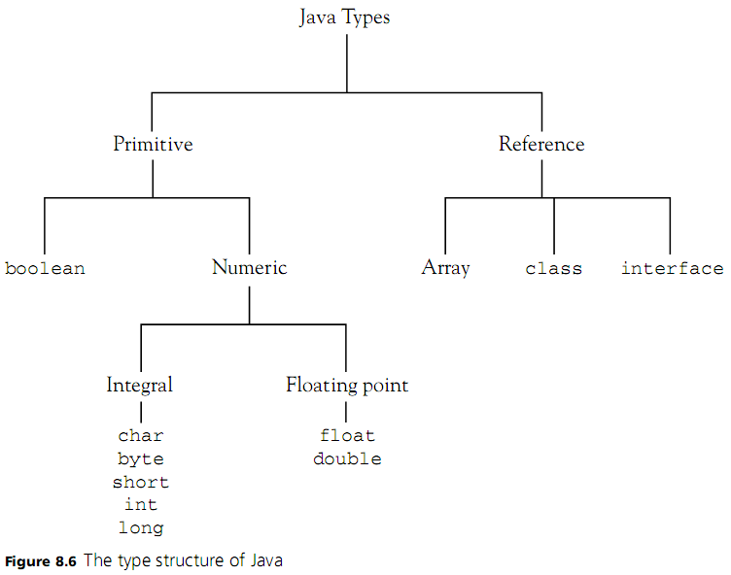
Programming Languages, Third Edition

Slide 50
Ada
Ada has a rich set of types
  Simple types are called scalar types
  Ordinal types are called discrete types
  Numeric types include real and integer types
  Pointer types are called access types
  Array and record types are called composite types
Programming Languages, Third Edition

Slide 51
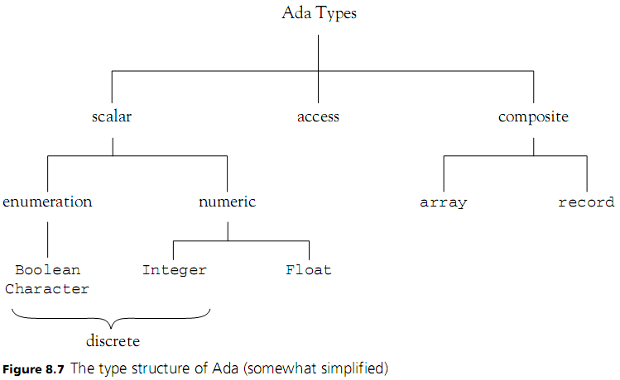
Ada (cont’d.)
Programming Languages, Third Edition

Slide 52
Type Equivalence
Type equivalence: when are two types the same?
Can compare the sets of values as sets
  Are the same if they contain the same values
Structural equivalence: two data types are the same if they have the same structure
  Built in the same way using the same type constructors from the same simple types
  This is one of the principal forms of type equivalence in programming languages
Programming Languages, Third Edition

Slide 53
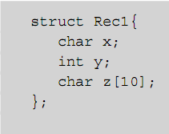
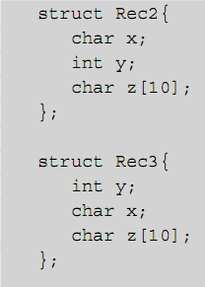
Type Equivalence (cont’d.)
Example:
  Rec1 and Rec2 are structurally equivalent
  Rec1 and Rec3 are not structurally equivalent (char and int fields are reversed)
Programming Languages, Third Edition

Slide 54
Type Equivalence (cont’d.)
Structural equivalence is relatively easy to implement (except for recursive types)
  Provides all the information needed to perform error checking and storage allocation
To check structural equivalence, a translator may represent types as trees and check equivalence recursively on subtrees
Questions still arise over how much information is included in a type under the application of a type constructor
Programming Languages, Third Edition

Slide 55

Type Equivalence (cont’d.)
Example: are A1 and A2 structurally equivalent?
  Yes, if size of the index set is not part of an array type
  Otherwise, no
Similar question arises regarding member names of structures
Programming Languages, Third Edition

Slide 56
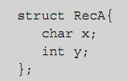
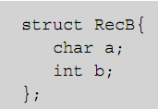
Type Equivalence (cont’d.)
Example: Are these two structures structurally equivalent?
  If structures are considered to be just Cartesian products, then yes
  They are typically not considered equivalent, because variables of different structures would have to use different names to access member data
Programming Languages, Third Edition

Slide 57
Type Equivalence (cont’d.)
Type names in declarations may or may not be given explicitly
  In C, variable declarations can use anonymous types
  Names can also be given right in structs and unions, or by using a typedef
Structural equivalence when type names are present can be done by simply replacing each name by its associated type expression in its declaration (except for recursive types)
Programming Languages, Third Edition

Slide 58
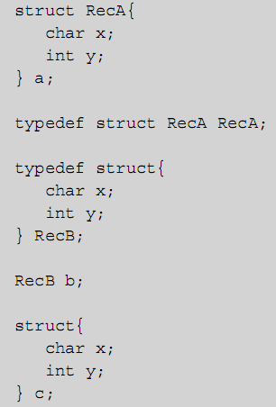
Type Equivalence (cont’d.)
Example: in C code
  Variable a has two names: struct RecA and RecA (given by the typedef)
  Variable b has only the name RecB (the struct name was left blank)
  Variable c has no type name at all (only an internal name not usable by the programmer)
Programming Languages, Third Edition

Slide 59
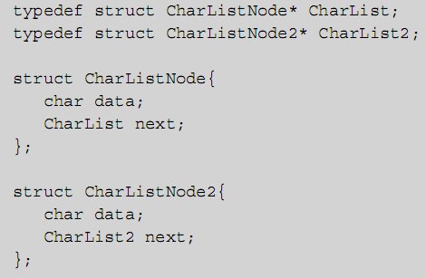
Type Equivalence (cont’d.)
Structural equivalence by replacing names with types can lead to infinite loops in a type checker when applied to recursive types
Programming Languages, Third Edition

Slide 60
Type Equivalence (cont’d.)
Name equivalence: two types are the same only if they have the same name
  Easier to implement than structural equivalence, as long as every type has an explicit name
  Two types are equivalent only if they are the same name
  Two variables are type equivalent only if their declarations use exactly the same type name
Programming Languages, Third Edition

Slide 61
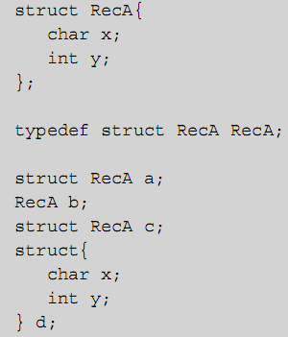
Type Equivalence (cont’d.)
Example: in C code:
  a, b, c, and d are structurally equivalent
  a and c are name equivalent, and not name equivalent to b or d
  b and d are not name equivalent to any other variable
Programming Languages, Third Edition

Slide 62
Type Equivalence (cont’d.)
Ada implements a very pure form of name equivalence
  Requires type names in variable and function declarations in virtually all cases
C uses a form of type equivalence that falls between name and structural equivalence:
  Name equivalence for structs and unions
  Structural equivalence for everything else
Pascal is similar to C, except that almost all type constructors lead to new, inequivalent types
Programming Languages, Third Edition

Slide 63
Type Equivalence (cont’d.)
Java’s approach is simple:
  It has no typedefs
  class and interface declarations implicitly create new type names, and name equivalence is used for these types
  Arrays use structural equivalence, with special rules for establishing base type equivalence
Programming Languages, Third Edition

Slide 64
Type Checking
Type checking: the process by which a translator verifies that all constructs are consistent
  Applies a type equivalence algorithm to expressions and statements
  May vary the use of the type equivalence algorithm to suit the context
Two types of type checking:
  Dynamic: type information is maintained and checked at runtime
  Static: types are determined from the text of the program and checked by the translator
Programming Languages, Third Edition

Slide 65
Type Checking (cont’d.)
In a strongly typed language, all type errors must be caught before runtime
  These languages must be statically typed
  Type errors are reported as compilation error messages that prevent execution
A language definition may not specify whether dynamic or static typing is used
Programming Languages, Third Edition

Slide 66
Type Checking (cont’d.)
Example1:
  C compilers apply static type checking during translation, but C is not strongly typed since many inconsistencies do not cause compilation errors
  C++ adds strong type checking, but mainly in the form of compiler warnings rather than errors, which do not prevent execution
Programming Languages, Third Edition

Slide 67
Type Checking (cont’d.)
Example 2:
  Scheme is a dynamically typed language, but types are rigorously checked
  Type errors cause program termination
  No types in declarations and no explicit type names
  Variables have no predeclared types, but take on the type of the value they possess
Programming Languages, Third Edition

Slide 68
Type Checking (cont’d.)
Example 3:
  Ada is a strongly typed language
  All type errors cause compilation error messages
  Certain errors, like range errors in array subscripting, cannot be caught prior to execution
  Such errors cause exceptions that will cause program termination if not handled by the program
Programming Languages, Third Edition

Slide 69
Type Checking (cont’d.)
Type inference: types of expressions are inferred from the types of their subexpressions
  Is an essential part of type checking
Type-checking rules and type inference rules are often intermingled
  They also have a close interaction with the type equivalence algorithm
Type inference and correctness rules are one of the most complex parts of the semantics of a language
Programming Languages, Third Edition

Slide 70
Type Compatibility
Two different types that may be considered correct when combined in certain ways are called compatible
  In Ada, any two subranges of the same base type are compatible
  In C and Java, all numeric types are compatible (and conversions are performed)
Assignment compatibility: the left and right sides of an assignment statement are compatible when they are the same type
  Ignores that the left side must be an l-value and the right side must be an r-value
Programming Languages, Third Edition

Slide 71
Type Compatibility (cont’d.)
Assignment compatibility can include cases where both sides do not have the same type
In Java, x=e is legal when e is a numeric type whose value can be converted to the type of x without loss of information
Programming Languages, Third Edition

Slide 72
Implicit Types
Implicit types: types that are not explicitly given in a declaration
  The type must be inferred by the translator, either from context information or from standard rules
In C, variables are implicitly integers if no type is given, and functions implicitly return an integer value if no return type is given
In Pascal, named constants are implicitly typed by the literals they represent
Literals are the major example of implicitly typed entities
Programming Languages, Third Edition

Slide 73
Overlapping Types and Multiply-Typed Values
Two types may overlap, with values in common
Although preferable for types to be disjoint, this would eliminate the ability to create subtypes through inheritance in object-oriented languages
In C, types like unsigned int and int overlap
In C, the literal 0 is a value for every integral type, a value of every pointer type, and represents the null pointer
In Java, the literal value null is a value of every reference type
Programming Languages, Third Edition

Slide 74
Shared Operations
Each type is associated, usually implicitly, with a set of operations
Operations may be shared among several types or have the same name as other operations that may be different
Example: + operator can be real addition, integer addition, or set union
Overloaded operation: the same name is used for different operations
  Translator must decide which operation is meant based on the types of the operands
Programming Languages, Third Edition

Slide 75
Type Conversion
Type conversion: converting from one type to another
  Can be built into the type system to happen automatically
Implicit conversion (or coercion): inserted by the translator
Widening conversion: target data type can hold all of the converted data without loss of data
Narrowing conversion: conversion may involve a loss of data
Programming Languages, Third Edition

Slide 76
Type Conversion (cont’d.)
Implicit conversion:
  Can weaken type checking so that errors may not be caught
  Can cause unexpected behavior if the conversion is done in a different way than the programmer expects
Explicit conversion (or cast): conversion directives are written into the code
  Conversions are documented in the code
  Less likelihood of unexpected behavior
  Makes it easier for the translator to resolve overloading
Programming Languages, Third Edition

Slide 77

Type Conversion (cont’d.)
Example In C++:
  Ambiguous, because of the possible implicit conversions from int to double on either first or second parameter
Java only permits widening implicit conversions for arithmetic types
C++ emits warning messages for narrowing
Programming Languages, Third Edition

Slide 78
Type Conversion (cont’d.)
Explicit casts need to be somewhat restricted
  Often to simple types, or just arithmetic types
If casts are permitted for structured types, they must have identical sizes in memory
  Allows translation to reinterpret the memory as a different type
Example: in C, malloc and free functions are declared using a generic pointer or anonymous pointer type void*
Object-oriented languages allow conversions from subtypes to supertypes and back in some cases
Programming Languages, Third Edition

Slide 79
Type Conversion (cont’d.)
Alternative to casts is to use predefined or library functions to perform conversions
  Ada uses attribute functions to allow conversions
  Java contains functions like toString to convert from int to String and parseInt to convert from String to int
Undiscriminated unions can hold values of different types
  With no discriminant or tag, a translator cannot distinguish values of one type from another
Programming Languages, Third Edition

Slide 80
Polymorphic Type Checking
Most statically typed languages required that explicit type information be given for all names in declarations
It is possible to determine types of names without explicit declaration:
  Can collect information on the uses of a name and infer the type from the set of all uses
  Can declare a type error because some of the uses are incompatible with others
This type inference and type checking is called Hindley-Milner type checking
Programming Languages, Third Edition

Slide 81
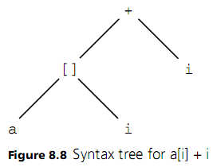
Polymorphic Type Checking (cont’d.)
Example in C code:
  a must be declared as an array of integers, and i as an integer, giving an integer result
Type checker starts out with this tree:
Programming Languages, Third Edition

Slide 82
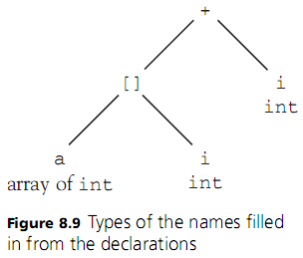
Polymorphic Type Checking (cont’d.)
Types of the names (leaf nodes) are filled in from declarations
Programming Languages, Third Edition

Slide 83
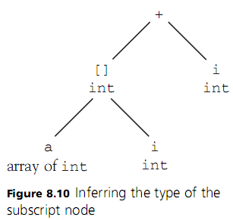
Polymorphic Type Checking (cont’d.)
Type checker now checks the subscript node (labeled [])
  Left operand must be an array
  Right operand must be an int
  Inferred type of the subscript node is the component type of the array - int
Programming Languages, Third Edition

Slide 84
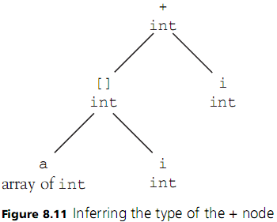
Polymorphic Type Checking (cont’d.)
+ node type is checked
  Both operands must have the same type
  This type must have a + operation
  Result is the type of the operands - int
Programming Languages, Third Edition

Slide 85
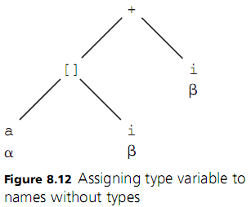
Polymorphic Type Checking (cont’d.)
Example: in C code:
  What if the declarations of a and i were missing?
Type checker would first assign type variables to all names that do not yet have types
Programming Languages, Third Edition

Slide 86
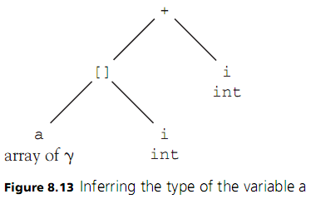
Polymorphic Type Checking (cont’d.)
Type checker now checks the subscript node
  Infers that a must be an array
  Infers that I must an int
  Replaces β with int in the entire tree
Programming Languages, Third Edition

Slide 87
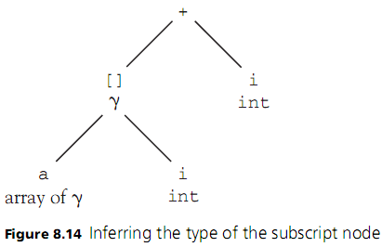
Polymorphic Type Checking (cont’d.)
Type checker now concludes that the subscript node is type correct and has the type γ
Programming Languages, Third Edition

Slide 88
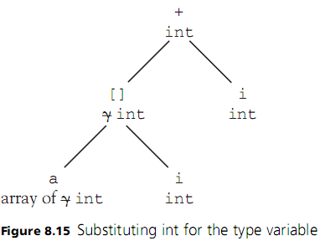
Polymorphic Type Checking (cont’d.)
+ node type is checked
  Concludes that γ must be type int
  Replaces γ everywhere by int
This is the basic form of operation of Hindley-Milner type checking
Programming Languages, Third Edition

Slide 89
Polymorphic Type Checking (cont’d.)
Once a type variable is replaced by an actual type, all instances of that variable name must be updated with the new type
  Called instantiation of type variables
Unification: when type expressions for variables can change for type checking to succeed
  Example array of α and array of β: we need to have α == β, so β must be changed to α everywhere it occurs
  Is a kind of pattern matching
Programming Languages, Third Edition

Slide 90
Polymorphic Type Checking (cont’d.)
Unification involves three cases:
  Any type variable unifies with any type expression (and is instantiated to that expression)
  Any two type constants unify only if they are the same type
  Any two type constructions (such as array or struct) unify only if they are applications of the same type constructor and all of their component types also recursively unify
Programming Languages, Third Edition

Slide 91
Polymorphic Type Checking (cont’d.)
Hindley-Milner type checking advantages:
  Simplifies the amount of type information the programmer must write
  Allows types to remain as general as possible while still being strongly checked for consistency
Hindley-Milner type checking implicitly implements polymorphic type checking
Array of α is a set of infinitely many types, called parametric polymorphism
  Hindley-Milner uses implicit parametric polymorphism
Programming Languages, Third Edition

Slide 92
Polymorphic Type Checking (cont’d.)
Sometimes called ad hoc polymorphism to distinguish it from overloading
Pure polymorphism (or subtype polymorphism): when objects that share a common ancestor also either share or redefine operators that exist for the ancestor
Monomorphic: describes a language that exhibits no polymorphism
Programming Languages, Third Edition

Slide 93


Polymorphic Type Checking (cont’d.)
Polymorphic functions are real goal of parametric polymorphism and Hindley-Milner type checking
Example:
  Body is the same if int is replaced by any other arithmetic type
  Could add a new parameter representing the >
Programming Languages, Third Edition

Slide 94

Polymorphic Type Checking (cont’d.)
In C-like syntax:
In ML legal syntax, this becomes:
Programming Languages, Third Edition

Slide 95
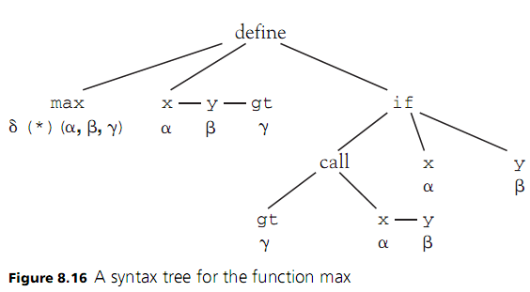
Polymorphic Type Checking (cont’d.)
Programming Languages, Third Edition

Slide 96
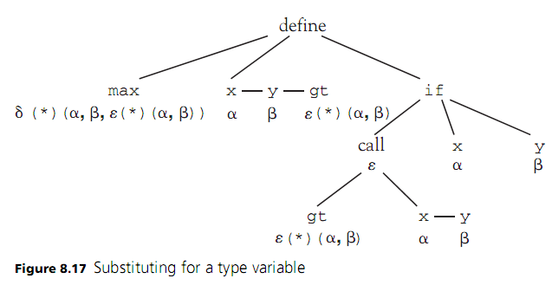
Polymorphic Type Checking (cont’d.)
Programming Languages, Third Edition

Slide 97
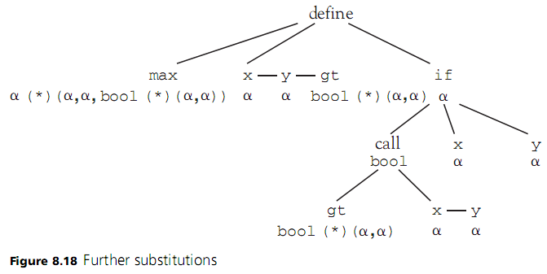
Polymorphic Type Checking (cont’d.)
Programming Languages, Third Edition

Slide 98


Polymorphic Type Checking (cont’d.)
Can now use max in any situation where the actual types unify
If we provide these definitions in ML:
  We can call max function as follows:
Programming Languages, Third Edition

Slide 99
Polymorphic Type Checking (cont’d.)
Most general type possible for max function, called its principal type, is:
Each call to max specializes this principle type to a monomorphic type
  May also implicitly specialize the types of the parameters
Any polymorphically typed object passed into a function as a parameter must have a fixed specialization for the duration of the function
  This restriction is called let-bound polymorphism
Programming Languages, Third Edition

Slide 100
Polymorphic Type Checking (cont’d.)
Two problems complicate Hindley-Milner type checking:
  Let-bound polymorphism
  The occur-check problem
Polymorphic types also have translation issues
  Copying values of arbitrary type without knowing the type means the translator cannot determine the size of the values
  May cause code bloat
Programming Languages, Third Edition

Slide 101

Explicit Polymorphism
Explicit parametric polymorphism: to define a polymorphic data type, the type variable must be written explicitly
Example: stack declaration in ML code
  Values of type Stack can be written as:
Programming Languages, Third Edition

Slide 102
Explicit Polymorphism (cont’d.)
Explicitly parameterized polymorphic data types are nothing more than a mechanism for creating user-defined type constructors
  A type constructor is a function from types to types
Construction can be expressed directly in C as a typedef
In ML, this is done with the type construct
C++ is a language with explicit parametric polymorphism, but without the associated implicit Hindley-Milner type checking
  Uses the template mechanism
Programming Languages, Third Edition

Slide 103
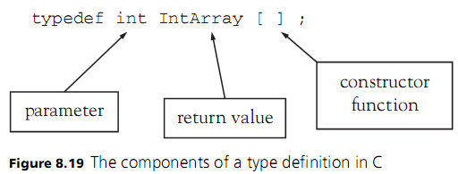
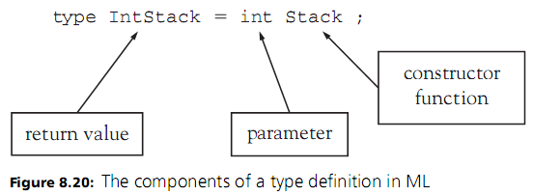
Explicit Polymorphism (cont’d.)
Programming Languages, Third Edition

Slide 104
Explicit Polymorphism (cont’d.)
Implicitly constrained parametric polymorphism: implicitly applies a constraint to the type parameter
Explicitly constrained parametric polymorphism: makes explicit what types of parameters are required
Programming Languages, Third Edition

Slide 105
Case Study: Type Checking in TinyAda
Goals:
  Check identifiers to ensure that they are declared before they are used
  Check that identifiers are not declared more than once in the same block
  Record the role of an identifier as a constant, variable, procedure, or type name
Programming Languages, Third Edition

Slide 106
Type Compatibility, Type Equivalence, and Type Descriptors
TinyAda parser must:
  Check that the type of an operand is appropriate for the operation being performed
  Check that the name on the left side of an assignment statement is type-compatible with the expression on the right side
  Restrict the types of certain elements of declarations, such as the index types of an array
Programming Languages, Third Edition

Slide 107
Type Compatibility, Type Equivalence, and Type Descriptors (cont’d.)
TinyAda uses a loose form of name equivalence to determine type compatibility
  For arrays and enumerations, two identifiers are type-compatible if and only if they were declared using the same type name in their declarations
  For built-in types INTEGER, CHAR, and BOOLEAN and their programmer-defined subrange types, two identifiers are type-compatible if and only if their supertypes are name-equivalent
Programming Languages, Third Edition

Slide 108
Type Compatibility, Type Equivalence, and Type Descriptors (cont’d.)
Type descriptor: primary data structure used to represent type attributes
Type descriptor is entered into the symbol table when the type name is introduced
  At startup for built-in type names INTEGER, CHAR, and BOOLEAN
  Whenever new type declarations are encountered
Programming Languages, Third Edition

Slide 109
The Design and Use of Type Descriptor Classes
Type descriptor is like a variant record, containing different attributes depending on the category of the data type being described
Each descriptor includes a type form field, with possible values of ARRAY, ENUM, SUBRANGE, and NONE, to identify the category of the data type
Array type descriptor includes attributes for index types and element types (these attributes are also type descriptors)
Enumeration type descriptor includes a list of symbol entries for the enumerate constant names
Programming Languages, Third Edition

Slide 110
The Design and Use of Type Descriptor Classes (cont’d.)
Type descriptors for subrange types (including INTEGER, CHAR, and BOOLEAN) include values of lower and upper bound and a type descriptor for the supertype
There is no variant record structure in Java
  Can model it with a TypeDescriptor class and three subclasses: ArrayDescriptor, SubrangeDescriptor, and EnumDescriptor
Programming Languages, Third Edition

Slide 111
Entering Type Information in Declarations
Type information must be entered wherever identifiers are declared in a source program
Type information comes from type identifiers or from a type definition
  Type identifiers: type descriptor is available in the identifier’s symbol entry
  Type definition: a new type might be created
Programming Languages, Third Edition

Slide 112
Checking Types in Operands in Expressions
The rules for TinyAda expressions give hints as to how their types should be checked
The type of every operand must be checked, and the correct type descriptor must be returned
Programming Languages, Third Edition

Slide 113
Processing Names: Indexed Component References and Procedure Calls
Syntax for TinyAda indexed component references and procedure calls is the same if the procedure expects at least one parameter
  Must distinguish between these two types of phrases, based on the role of the leading identifier
Programming Languages, Third Edition

Slide 114
Completing Static Semantic Analysis
Two other types of semantic restrictions can be imposed during parsing:
  Checking of parameter modes
  Check that only static expressions are used in number declarations and range type definitions
Tanya has three parameter modes:
  Input only: with the keyword in
  Output only: with the keyword out
  Input/output: with the keywords in out
Programming Languages, Third Edition

